Slide 1

Eternity Calculator for sinh(x) Support
Prepared by:-
Abideep Singh Kondal
40241215
<<D1 deliverable>>
Monday, 14 July 2025

Slide 2
Deliverable 1 – Problems
Problem 1 – Context of Use Model
Construct a context of use model for your function using the knowledge of the technical as well as non-technical environment of a calculator.
Problem 2 – Requirements Specification
Express requirements of your function based on the ISO/IEC/IEEE 29148 Standard.
Associate each requirement with a unique identifier.
Use of a requirements tool is encouraged.
Problem 3 – Java CLI Implementation
Implement your function in Java.
The implementation must include a textual user interface (e.g., command-line interface) for both input and output.

Slide 3
Agenda
This project so far implements the scientific function sinh(x) using first-principles Java programming[8]. The function is embedded within a console-based calculator called Eternity Calculator (for sinh(x) Support).
This implementation follows ISO/IEC/IEEE 29148[7] standards for requirements and includes a contextual model.
The system is designed for both iterative and incremental development[5], with future enhancements (GUI, testing frameworks, accessibility) planned in D2 and D3.

Slide 4
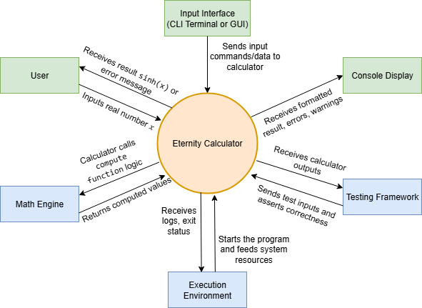
Context of Use Model
Users[6] include students, researchers, and engineers solving scientific problems.
Inputs are given via a CLI (keyboard), and outputs are shown on a console.
Math.exp() is used for calculation using Java’s Math Engine.
Testing and debugging are supported in a standalone Java runtime.
The context ensures the program is portable, testable, and suitable for demos and scripting.
Diagram made using – draw.io[10]

Slide 5
Requirements – Functional
REQ-1 | The calculator shall accept a real number input x via the keyboard.
REQ-2 | The calculator shall compute sinh(x) using the formula (e^{x}−e^{−x})/2.
REQ-3 | The calculator shall round and display the result of sinh(x) to 6 decimal places.
REQ-4 | The calculator shall restrict input values to the range [−100,100] and display an appropriate warning if out of bounds.
REQ-5 | The calculator shall support repeated computations until the user chooses to exit

Slide 6
Requirements – Non-Functional
REQ-6 | The calculator shall return the result within 100 milliseconds for valid inputs in the allowed range.
REQ-7 | The system shall run on any platform that supports Java SE 8 or higher[9].
REQ-8 | The system shall handle malformed input (e.g., non-numeric input) gracefully and prompt the user to retry.
REQ-9 | The implementation shall support unit testing using standard Java test frameworks (e.g., JUnit).

Slide 7
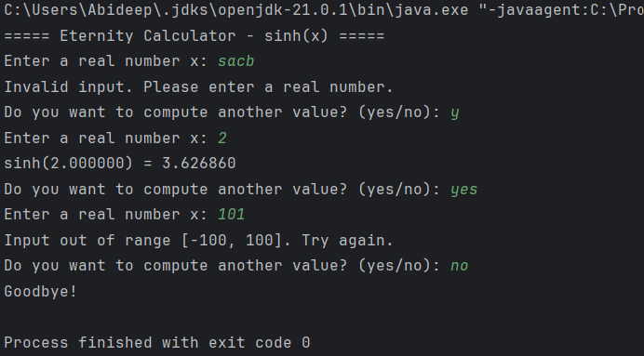
Java Implementation Overview
Developed in Java[8][9] using standard I/O and Math.exp().
Console-based interaction, no dependencies.
Loop continues until user exits with “no”.
Input validation included for range and type.
Link to repository : https://github.com/DeepKondal/Eternity

Slide 8
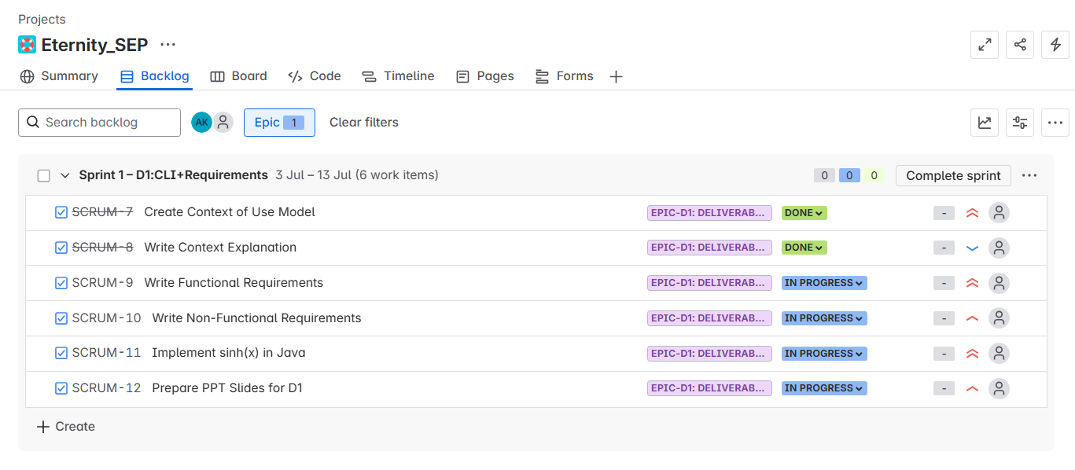
Agile Planning with Jira
The Eternity Calculator project is managed using Jira[11] to align with the agile and DevOps-inspired[4] structure of the course.
Tasks for Deliverable 1 are grouped under Epic-D1 and are individually tracked with progress status.

Slide 9
Relevance to coursework
In this deliverable, I applied several software engineering techniques[5] emphasized in the course.
I used brainstorming[1][2] to identify technical and non-technical factors influencing the calculator's usage, which guided the creation of the Context of Use Model.
I employed mind mapping[3] to visually represent system interactions and dependencies between components such as the user[6], input/output interfaces, and the math engine.
The project was developed using an iterative and incremental[5] approach, where context modeling informed the requirements, which then shaped the implementation.
Additionally, I used Jira for task organization[4] and sprint planning

Slide 10
Conclusion and What’s Next
What's Completed?:
Context of use model
ISO-standard requirements
Java implementation (CLI)
Upcoming in D2/D3:
Full GUI with Swing/JavaFX
Custom implementation without using any external Libraries
Exception handling, testing tools, static analysis
Accessibility and styling validation
Updated requirements

Slide 11
References
[1]Brainstorming and Beyond: A User-Centered Design Method.By C. Wilson. Morgan Kaufmann, 2013.
[2]Supporting Brainstorming Activities with Bots in Software Engineering Education.By J. C. Farah, J. L. Scala, S. Ingram, D. Gillet. 2019.
[3]Mind Mapping For Dummies.By F. Rustler. John Wiley and Sons, 2012.Developing a Glossary for Software Projects.By T. Abdou, P. Kamthan, N. Shahmir. 2021.
[4]Towards an Understanding of Collaborations in Agile Course Projects.By P. Kamthan. 2021.
[5]Introduction to Software Processes (Course Handout).By P. Kamthan. Concordia University, 2025.
[6]Introduction to User Modeling (Course Handout).By P. Kamthan. Concordia University, 2025.
[7]ISO/IEC/IEEE. Systems and software engineering — Life cycle processes — Requirements engineering (ISO/IEC/IEEE 29148:2018). Geneva: International Organization for Standardization, 2018.
[8]Java Documentation https://docs.oracle.com/en/java/javase/21/
[9]IntelliJ Accessibility Support https://www.jetbrains.com/help/idea/accessibility.html
[10]Draw.io Diagram Tool https://www.drawio.com/doc/
[11] https://confluence.atlassian.com/jira

Slide 12
Thank you
Thank you
Any questions?

